Slide 1
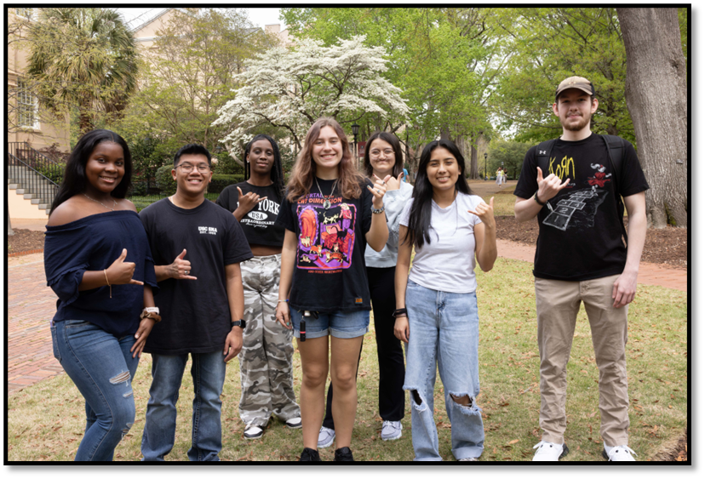
First-Gen Defined
A first-gen student is any individual whose parents did not complete a bachelor's degree.
Notes:
Melissa
At the University of South Carolina, we utilize the national Trio definition of First-Generation.
List other individuals who can subscribe to our newsletter (parents received bachelor’s in another country; grad students whose parents only received a bachelor’s degree.
1

Slide 2
Total First-gen enrollment Undergrad (Full & Part-time)
 | % | #
Fall 2023 | 20.3% | 5,766
Fall 2024 | 20.2% | 6,079
Fall 2025 | 20.9% | 6,655
Source: OIRRA Enrollment Dashboard
Notes:
In Fall 2025, 6,655 undergraduate first-generation students were enrolled at the university, representing a 9.48% increase from Fall 2024.

Slide 3
Fall 2025 First-gen Data points
Did You Know:
78.12% are South Carolina residents
51.47% receive the Pell Grant
139 residents in the First-Generation Living and Learning Community (93% occupancy)
8% of Education Abroad participants in 2024-2025 were first-gen
52% of Magellan Journey Grant applicants were first-gen students
Source: OIRRA Enrollment Dashboard & Office’s Departmental Data
Notes:
Hi LaNae’,
We track our annual data from August 15-August 14 due to the dates of summer programs, but it was 8% during the August 2024-August 2025 academic year. I think TRIO not running its program last year is the primary reason. We have a special FG page in our annual report – page 18: https://heyzine.com/flip-book/f3a93cdb1f.html#page/19.
Looking forward to the workshop! Best, Morgan
Although our students come from different socioeconomic backgrounds, it’s important to note over half of our first-gen students demonstrate exceptional financial need.

Slide 4
Fall 2025 percentage of first-gen undergraduates in each college & School
McCausland College of Arts & Sciences: 23.9% | Darla Moore School of Business: 13.8%
College of Education: 26.4% | Molinaroli College of Engineering and Computing: 24.6%
College of Hospitality, Retail and Sport Management: 14.6% | College of Information and Communications: 18.4%
School of Music: 22.8% | College of Nursing: 24.6%
College of Pharmacy: 31.1% | Arnold School of Public Health: 21.7%
College of Social Work: 40.5% | Honors College: 8.9%
Source: Enrolled Students by Attribute Report, December 3, 2025

Slide 5
A nod to first-gen efforts
TRIO Programs
First-Generation Center
First-Generation Living and Learning Community
College and School efforts
Campus office initiatives
Student organization involvement

